Slide 1
SeaScape 2019: a Preliminary Investigation of Speciated Secondary Marine Aerosol Precursors
Emily Barnes, Robin Weber, Mike Alves, Delaney Kilgour, Jon Sauer, Alexia Moore, Lindsay Yee, Nathan Kreisberg, Allen Goldstein

Slide 2
Big Picture:
Detailed and Quantitative View into Organic Composition of SSA
Detailed and Quantitative View into Composition of marine VOC’s
Collective properties/dominant functional groups as f(Bacteria/Phytoplankton density):
Biological Controls on Aerosol Properties?
Source material for SMA formation:
Oxidative Aging and Cloud Properties
Light sensitivity/ dependence? Photochem!
Identities/ concentrations of specific observed acids: PH?
Notes:
This summer I collected three types of samples: I collected primary submicron SSA from a sampling port just past the breaking wave, I collected VOC’s off of the isolated headspace dome, and I collected VOC’s off of a photolysis tube in coordination with APCI-Orbitrap work by Mike Alves

Slide 3
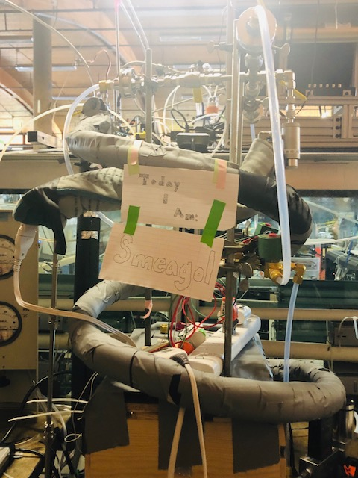
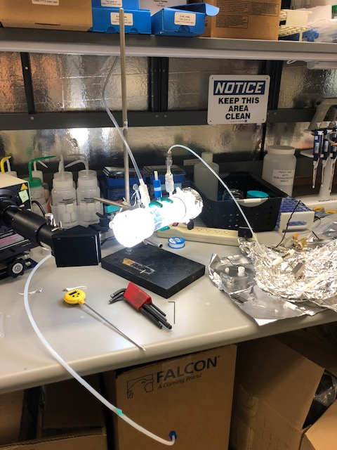
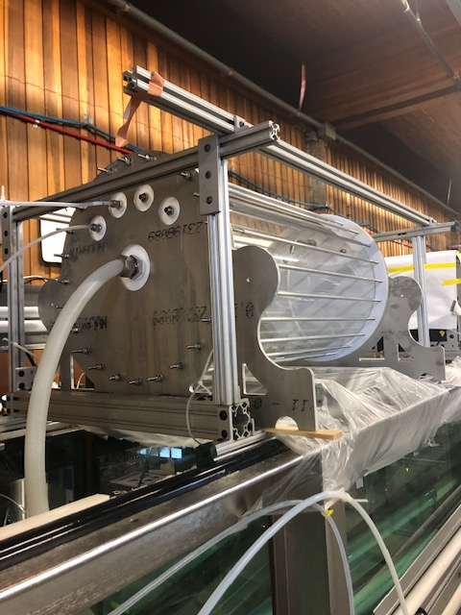
Methodology: Sampling
Nascent
VOC’s
Octo-Dome
Photolysis
Notes:
This summer I collected three types of samples: I collected primary submicron SSA from a sampling port just past the breaking wave, I collected VOC’s off of the isolated headspace dome, and I collected VOC’s off of a photolysis tube in coordination with APCI-Orbitrap work by Mike Alves

Slide 4
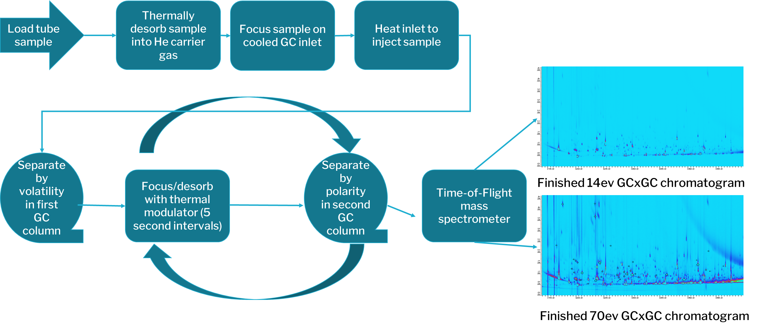
Methodology: TD-GCxGC-EI-HR-MS

Slide 5
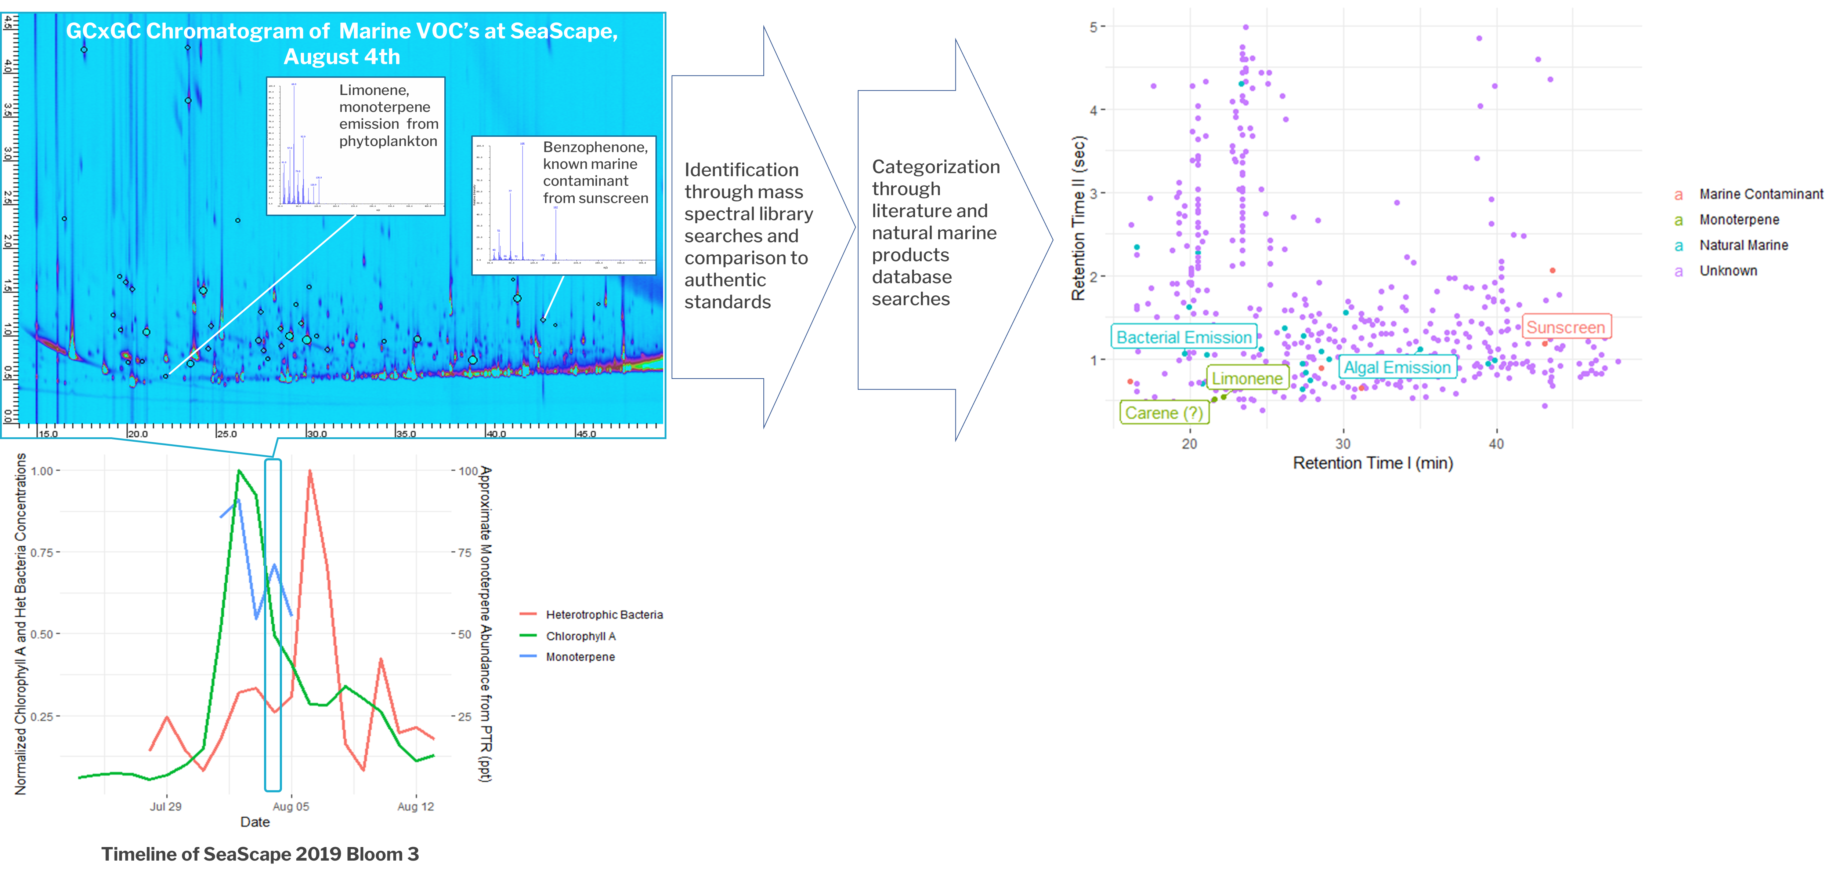
Preliminary Results: Bloom 3 Test
Notes:
A fraction of the compounds in this sample have been identified through EI nist searches and categorized by where they are referenced in the literature and in marine natural products databases with the following results

Slide 6
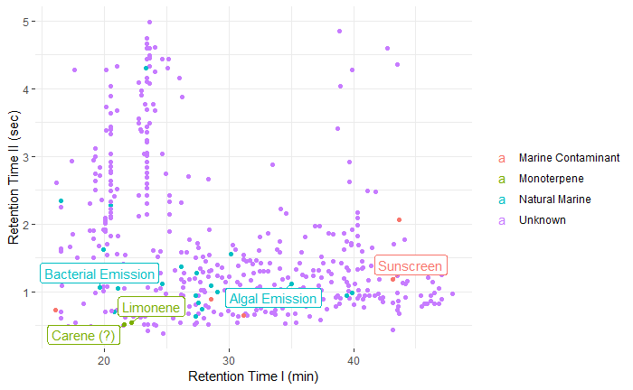
Preliminary Results: Bloom 3 Test
~450 above-background VOC’s observed
Distribution of PTR-observed monoterpenes in Bloom Three between at least two distinct species confirmed
Compounds indicative of phytoplankton activity, bacterial activity, and anthropogenic marine contamination identified
Method development for novel application of TD-GCxGC to marine VOC’s achieved

Slide 7
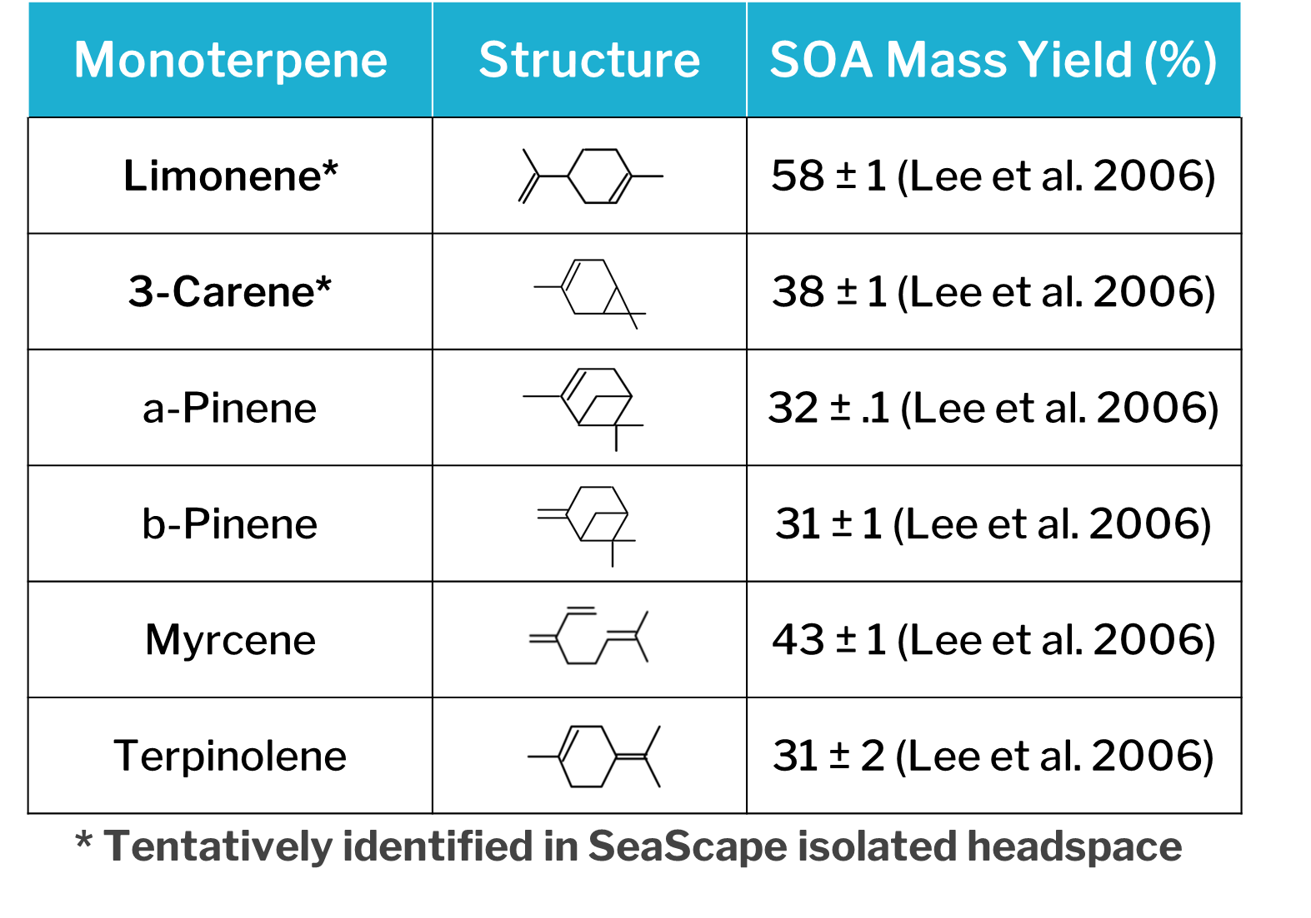
Significance: Why Speciate?
Notes:
Isomer-specific speciation of marine VOC’s is critical to understanding and characterizing secondary marine aerosol formation and atmospheric chemistry impacts.
different arrangements of elements in compounds with the same molecular formula oxidize differently and form different quantities of aerosol with different characteristics.
For example: different monoterpene (C10H16) species exhibit secondary organic aerosol (SOA) yields varying by up to a factor of two
Chemical reaction pathways governing marine VOC fate and aerosol formation can only be fully understood and modeled when specific precursor suites have been identified

Slide 8
Significance: Novel Observations
Oxidant-free headspace sweep analysis of VOC’s produced by marine monocultures
+ Capacity to observe highly reactive VOC emissions and tie them directly to microbio activity
Limited applicability to real marine systems
Field observations of VOC concentrations above real algal blooms
+ Yields information about real marine systems
Highly reactive VOC’s gone before they can be sampled
Ability to rule out terrestrial influences limited
Many uncontrollable constantly changing factors, identifying cause/effect challenging
Caice SeaScape Dome
+ VOC emissions from a realistic, diverse, dynamic microbio community emitted in oxidant and particle-free environment
+ Characteristics of entire system extensively monitored and where possible controlled
- Temperature and nutrient conditions unrealistic
Notes:
The unique design of the SeaScape Dome enables previously impossible observations under quasi in-situ conditions
Short-lived VOC’s, which are rapidly lost to oxidation or condensation onto existing particles over the open ocean, are here preserved in an oxidant and particle-free environment
This generates unique opportunities to trace marine VOC influences on atmospheric chemistry to the source and explore emissions profiles under warm and nutrient dense (futuristic?) conditions

Slide 9
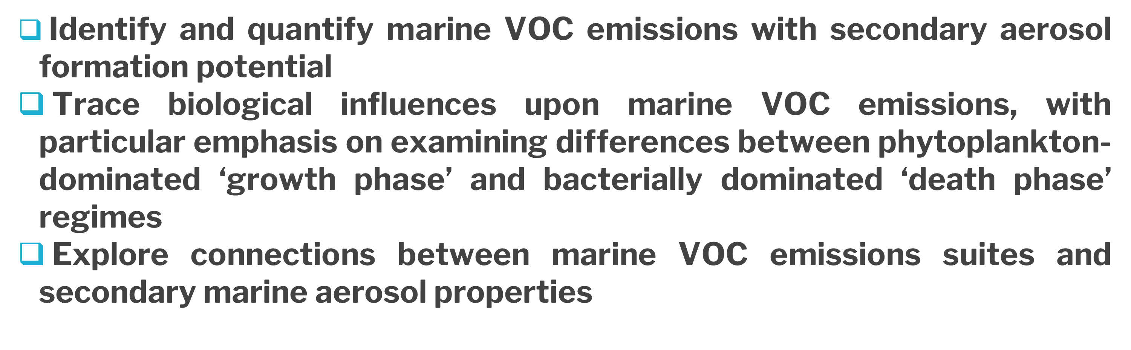
Guiding Science Goals
Notes:
That will guide the continuation of my SeaScape VOC work

Slide 10
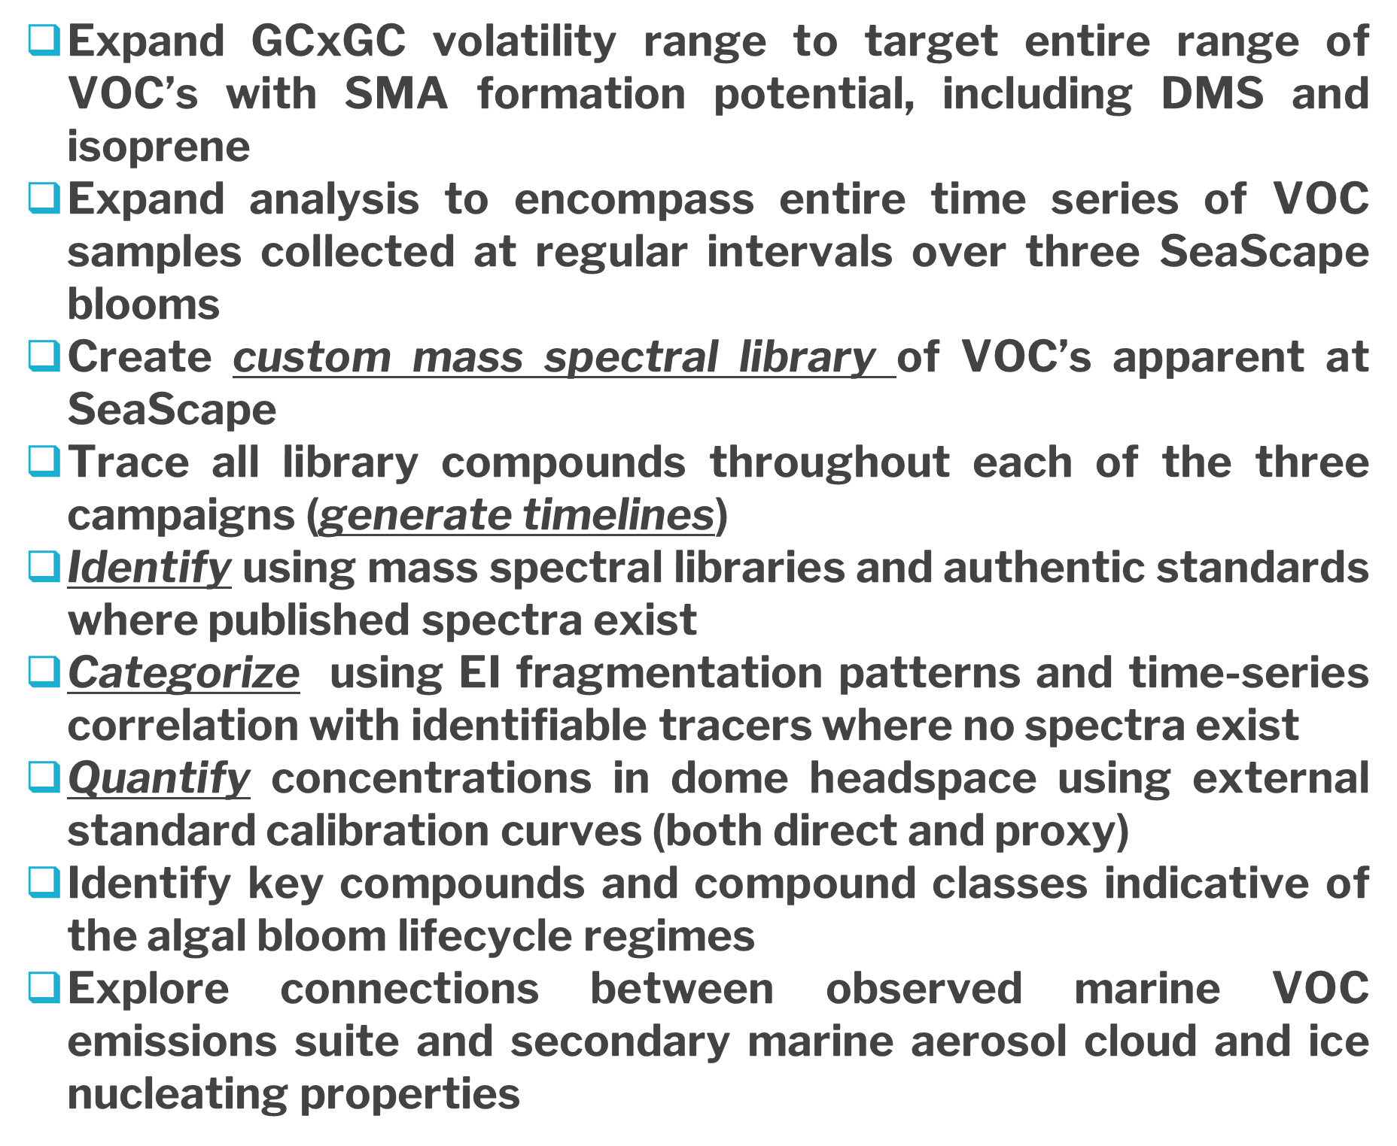
Next Steps
New columns
~150 standards covering volatility/polarity range and representative of major compounds/compound classes of interest

Slide 11
Next Steps
Run Cal curves/entire time series through end of year

Slide 12
Next Steps
Analyze Spring 2020

Slide 13
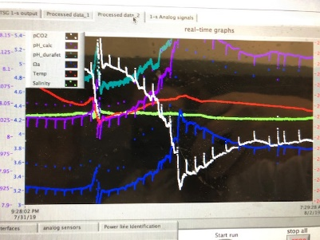
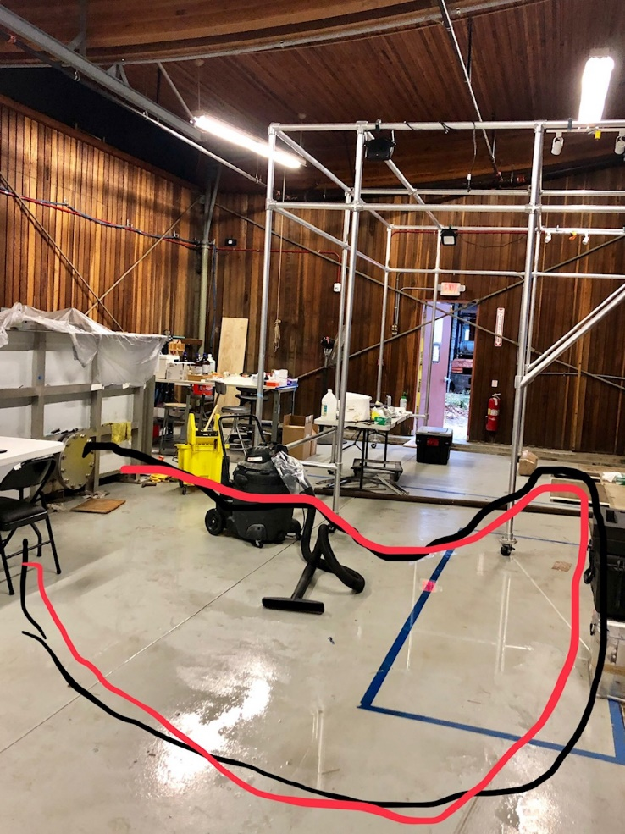
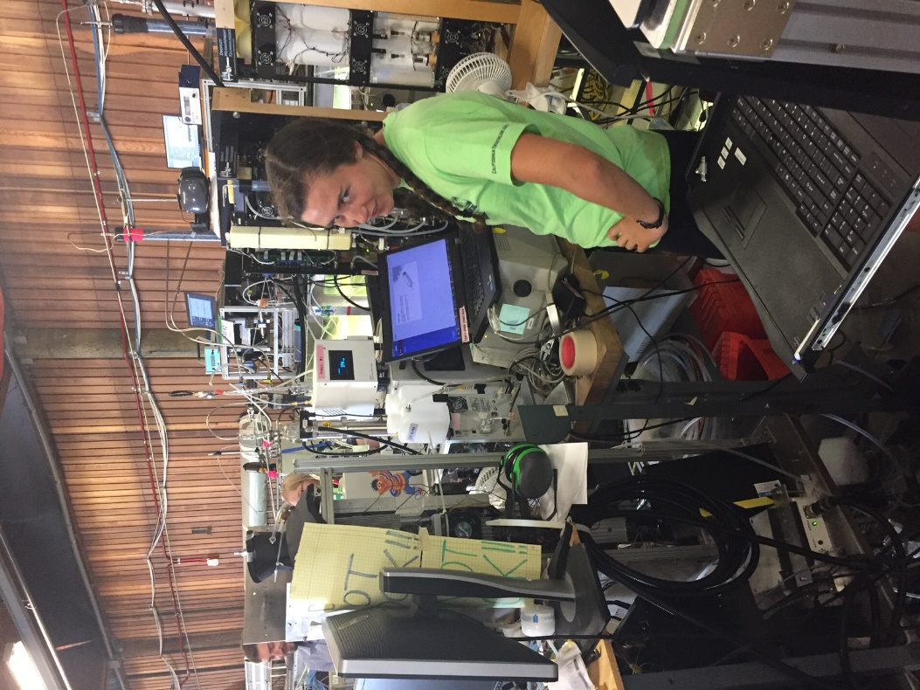
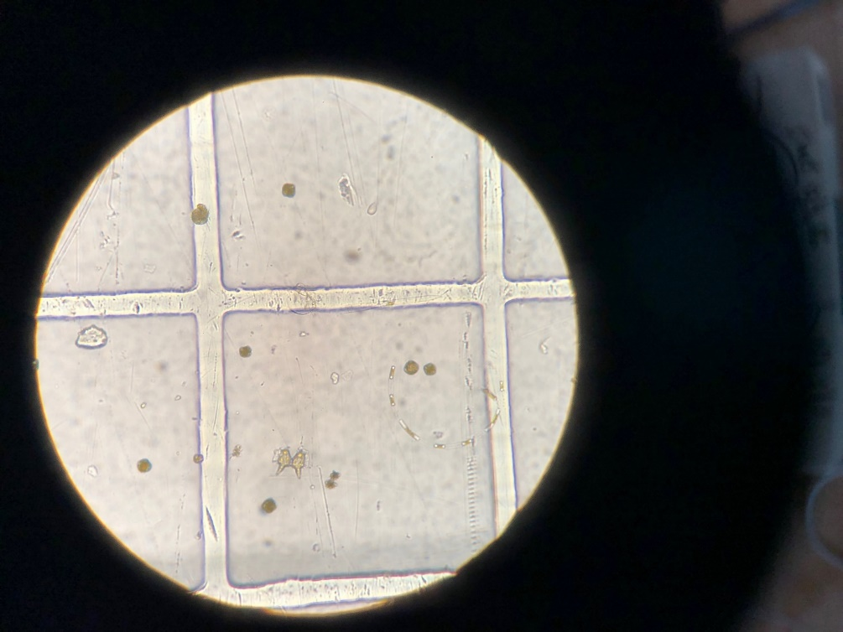
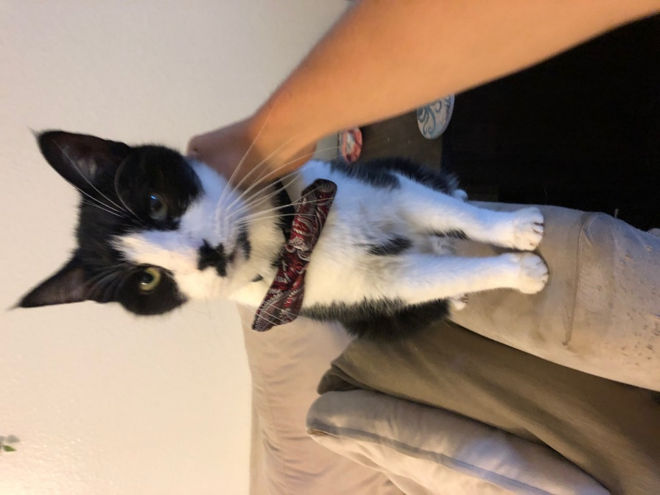
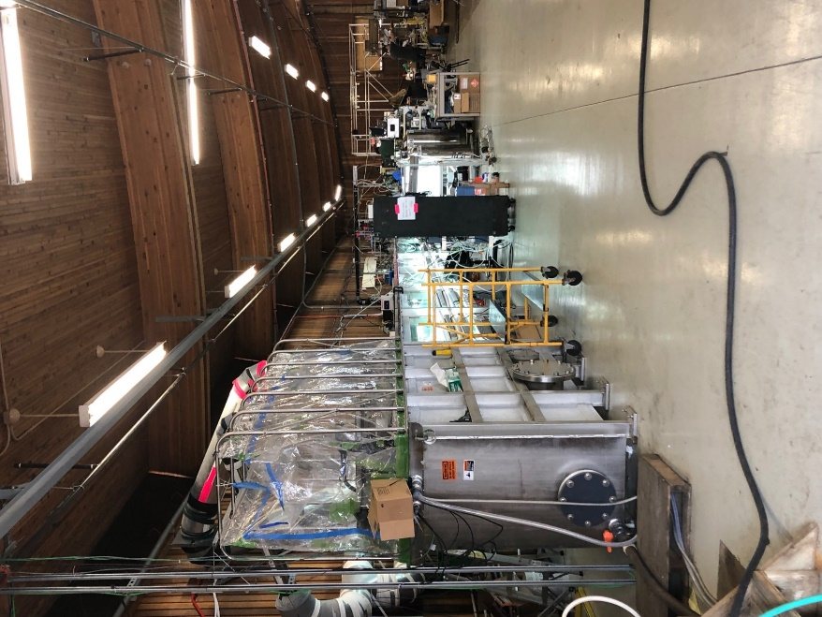
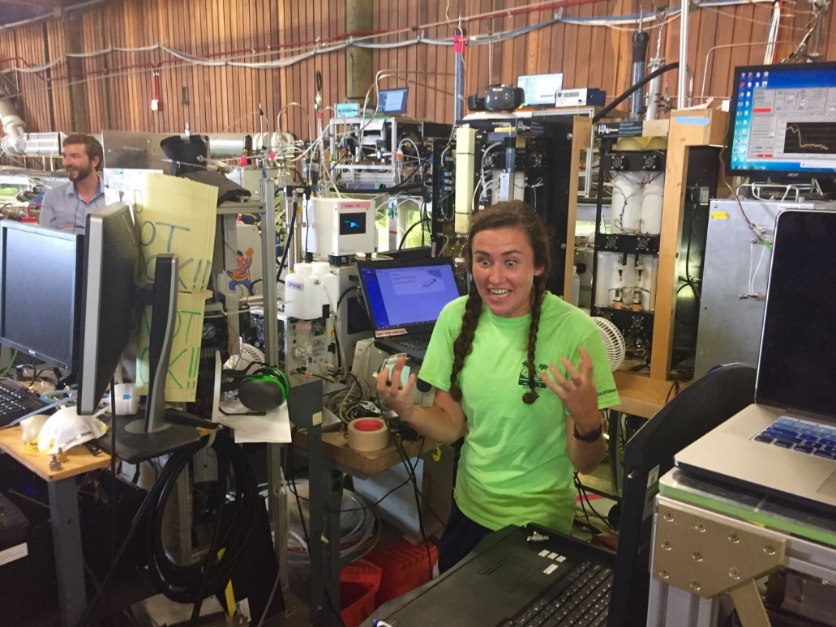
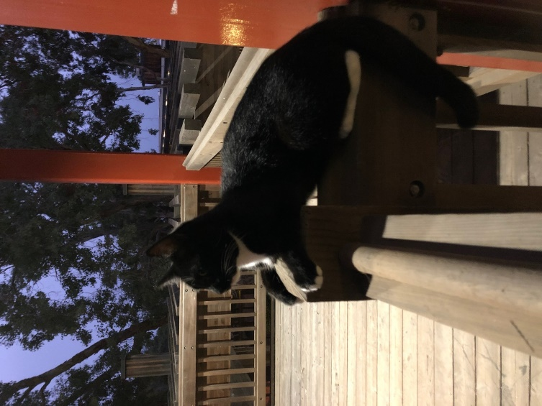
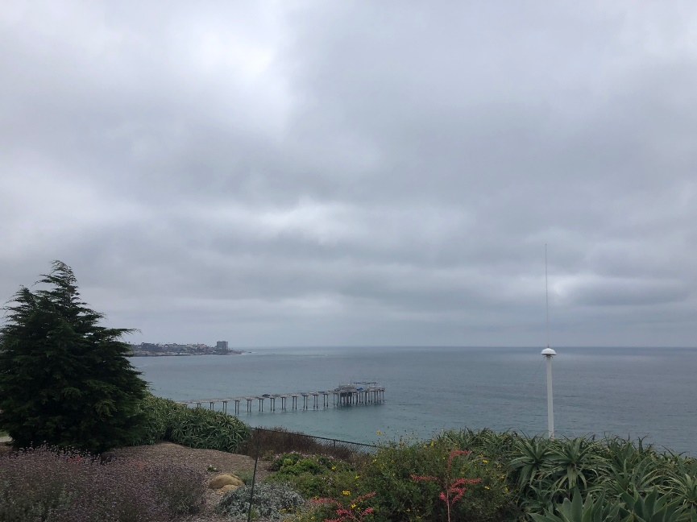
SeaScape 2019
Notes:
SeaScape was an intense experience, and despite(or maybe because of?) that nobody really took very many pictures- in fact the two in the corners are the only ones with me in them from the whole campaign. Each one of these has a story and is very funny to me for one reason or another, but is largely irrelevant to the science on the whole so I thought I would throw them up to give a sense of local flavor

Slide 14
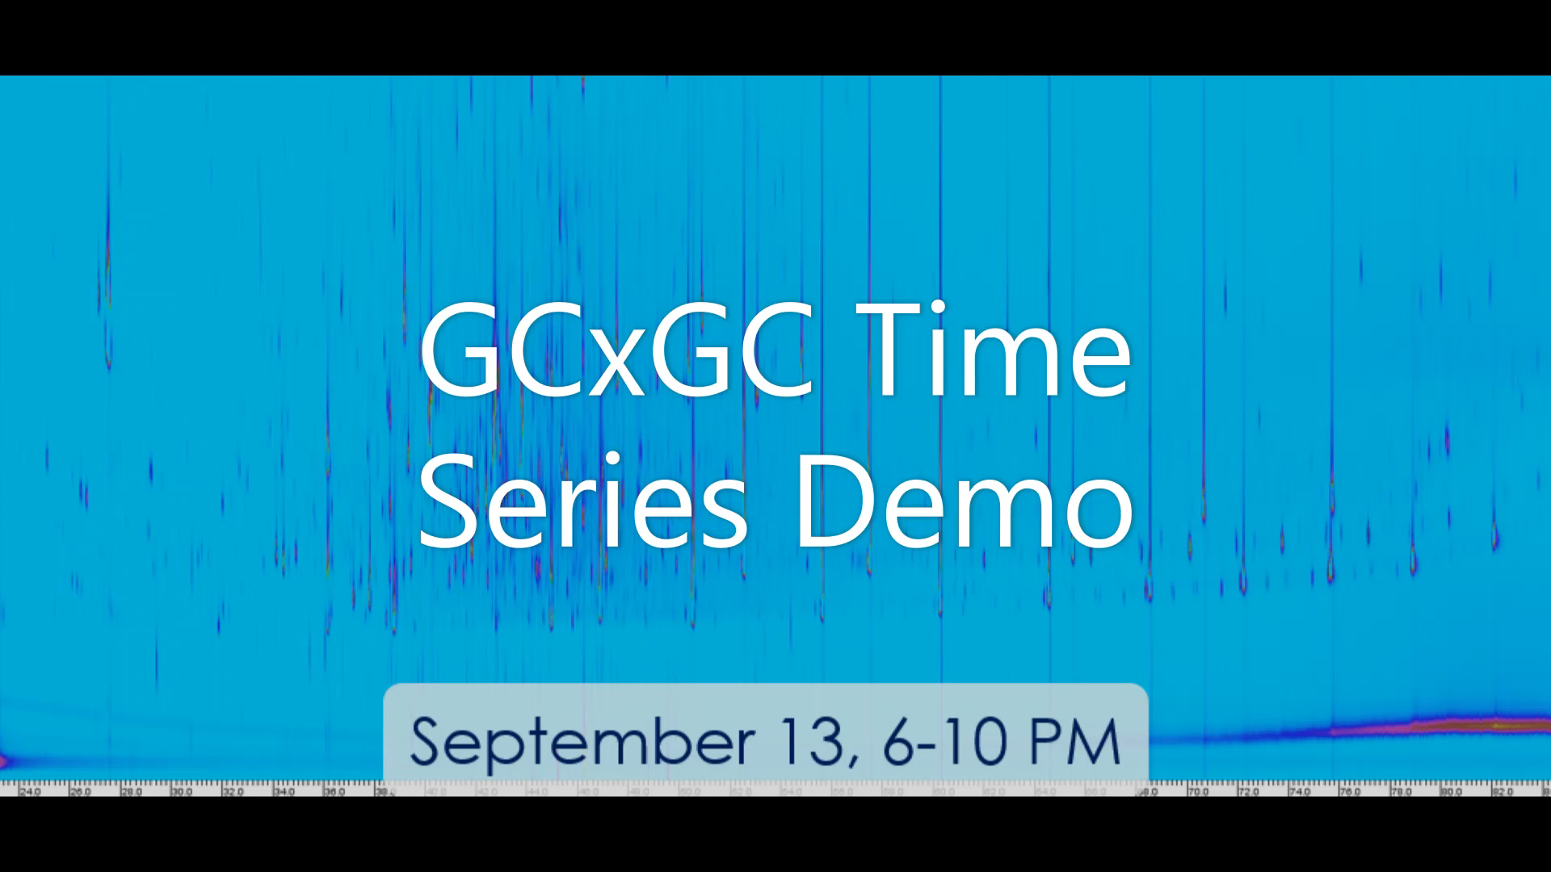
GCxGC Method Development- Amazon Progress
Notes:
That will guide the continuation of my SeaScape VOC work

Slide 15
Analysis Workflow
Run entire series using typical EI ionization (70 ev)
Create time series of each library compound throughout study period
Re-analyze representative samples with VUV soft ionization (10.5 ev) to obtain parent masses
Identify representative/ chemically interesting periods
Yes!
Identify/categorize analytes using standards, EI libraries, parent masses, fragmentation patterns, tracer correlations, etc.
Compile custom library of unique analytes from representative samples
No
Quantify and correct time series using cal curves of representative standard mixture
Test library on time series: does it contain on average >90% analyte mass?

Slide 16
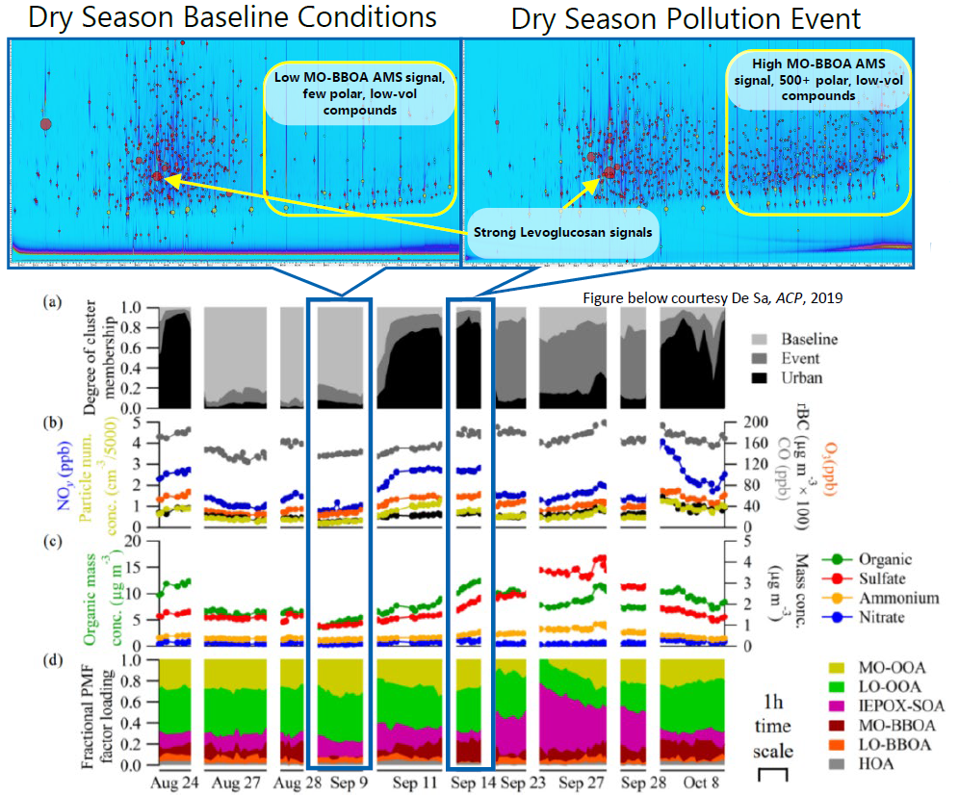
Select Samples and Create Library

Slide 17
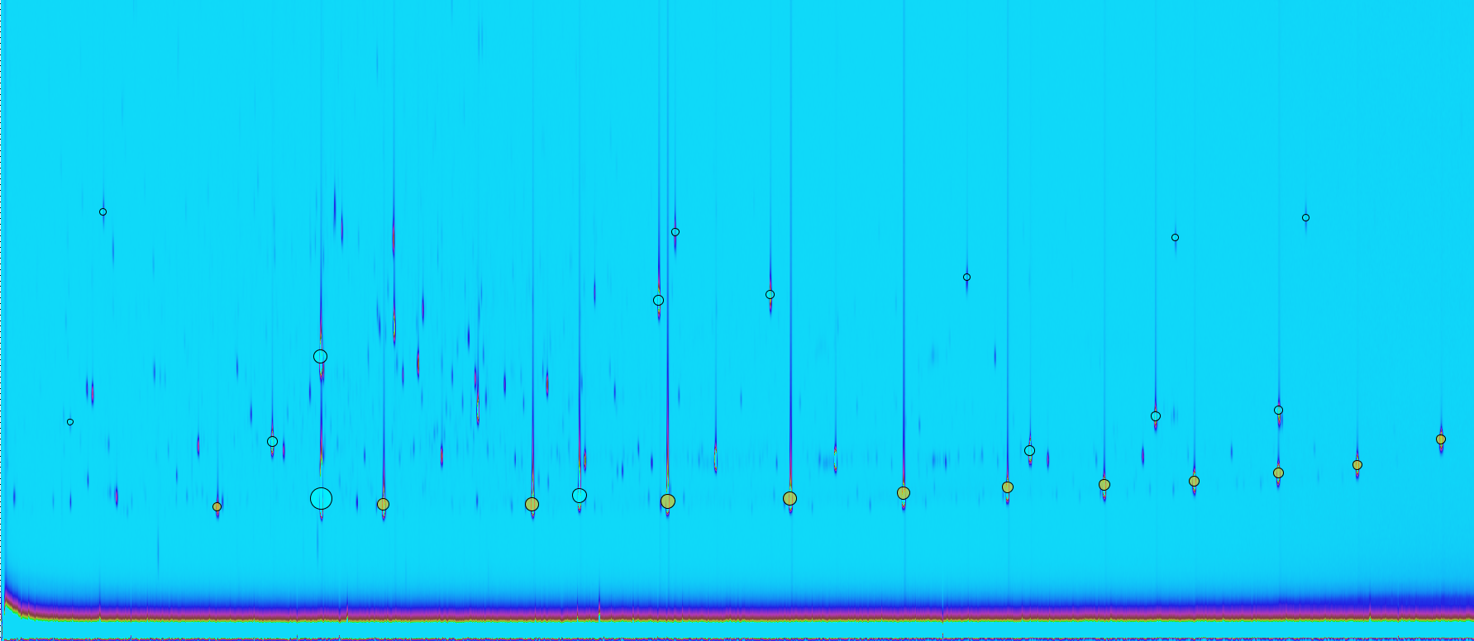
Trace Each Compound Through Campaign: Internal Standard Modeling
Notes:
The somewhat unique aspect of this analysis method: untargeted
GCxGC gives enhanced separation so it is usually used to look at targeted analytes in a clean fashion, we are really pushing to embrace the entirety and complexity of the data generated

Slide 18
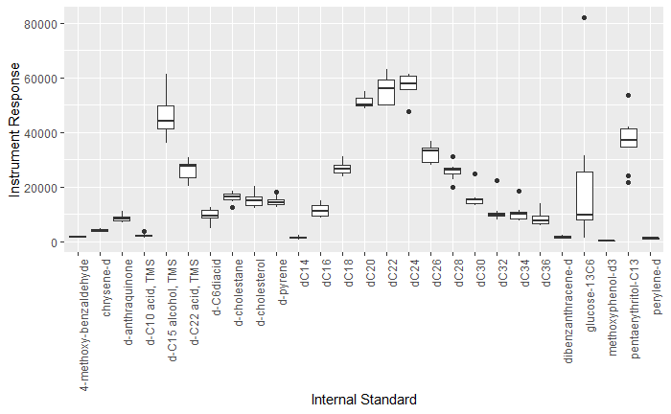
Trace Each Compound Through Campaign: Internal Standard Modeling
Notes:
The somewhat unique aspect of this analysis method: untargeted
GCxGC gives enhanced separation so it is usually used to look at targeted analytes in a clean fashion, we are really pushing to embrace the entirety and complexity of the data generated

Slide 19
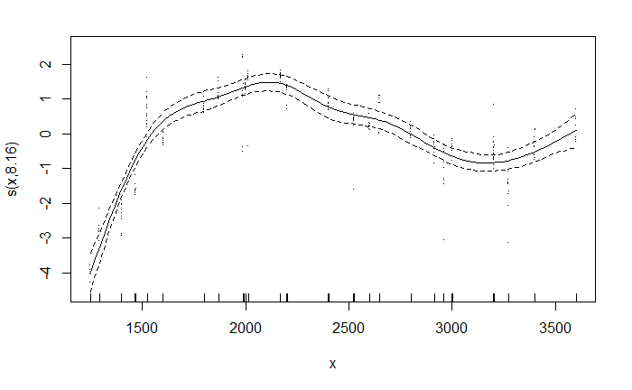
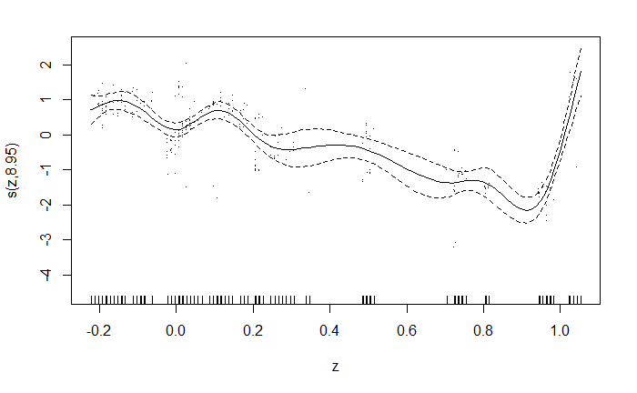
Trace Each Compound Through Campaign: Internal Standard Modeling
Create a GAM (Generalized Additive Model) mapping instrument response according to 3 factors:
First dimension position (volatility proxy)
Second dimension position ( polarity proxy)
Sample number (total sample loading proxy)
1 and 2 correct for the instrument’s sensitivity limitations at the ends of the volatility and polarity ranges; 3 corrects for matrix effects
Volatility Index
Polarity Index
Notes:
The somewhat unique aspect of this analysis method: untargeted
GCxGC gives enhanced separation so it is usually used to look at targeted analytes in a clean fashion, we are really pushing to embrace the entirety and complexity of the data generated

Slide 20
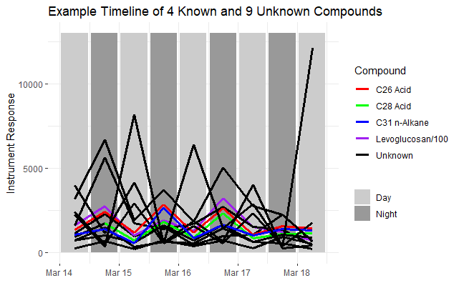
Trace Each Compound Through Campaign: Timelines
Notes:
The somewhat unique aspect of this analysis method: untargeted
GCxGC gives enhanced separation so it is usually used to look at targeted analytes in a clean fashion, we are really pushing to embrace the entirety and complexity of the data generated

Slide 21
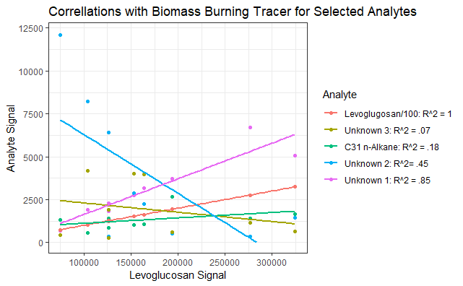
Identify, Categorize, Explore

Slide 22
CAICE Science Goals
Identify and quantify algal bloom organic emissions (gas phase and nascent SSA)
Observe diurnal variability and biological activity dependence of ICN and CCN-relevant organics in SSA
Characterize emissions of short-lived marine VOC’s (e.g. mono- and sesquiterpenes(?)) over course of bloom
Observe and characterize marine VOC emissions in response to photolysis

Slide 23
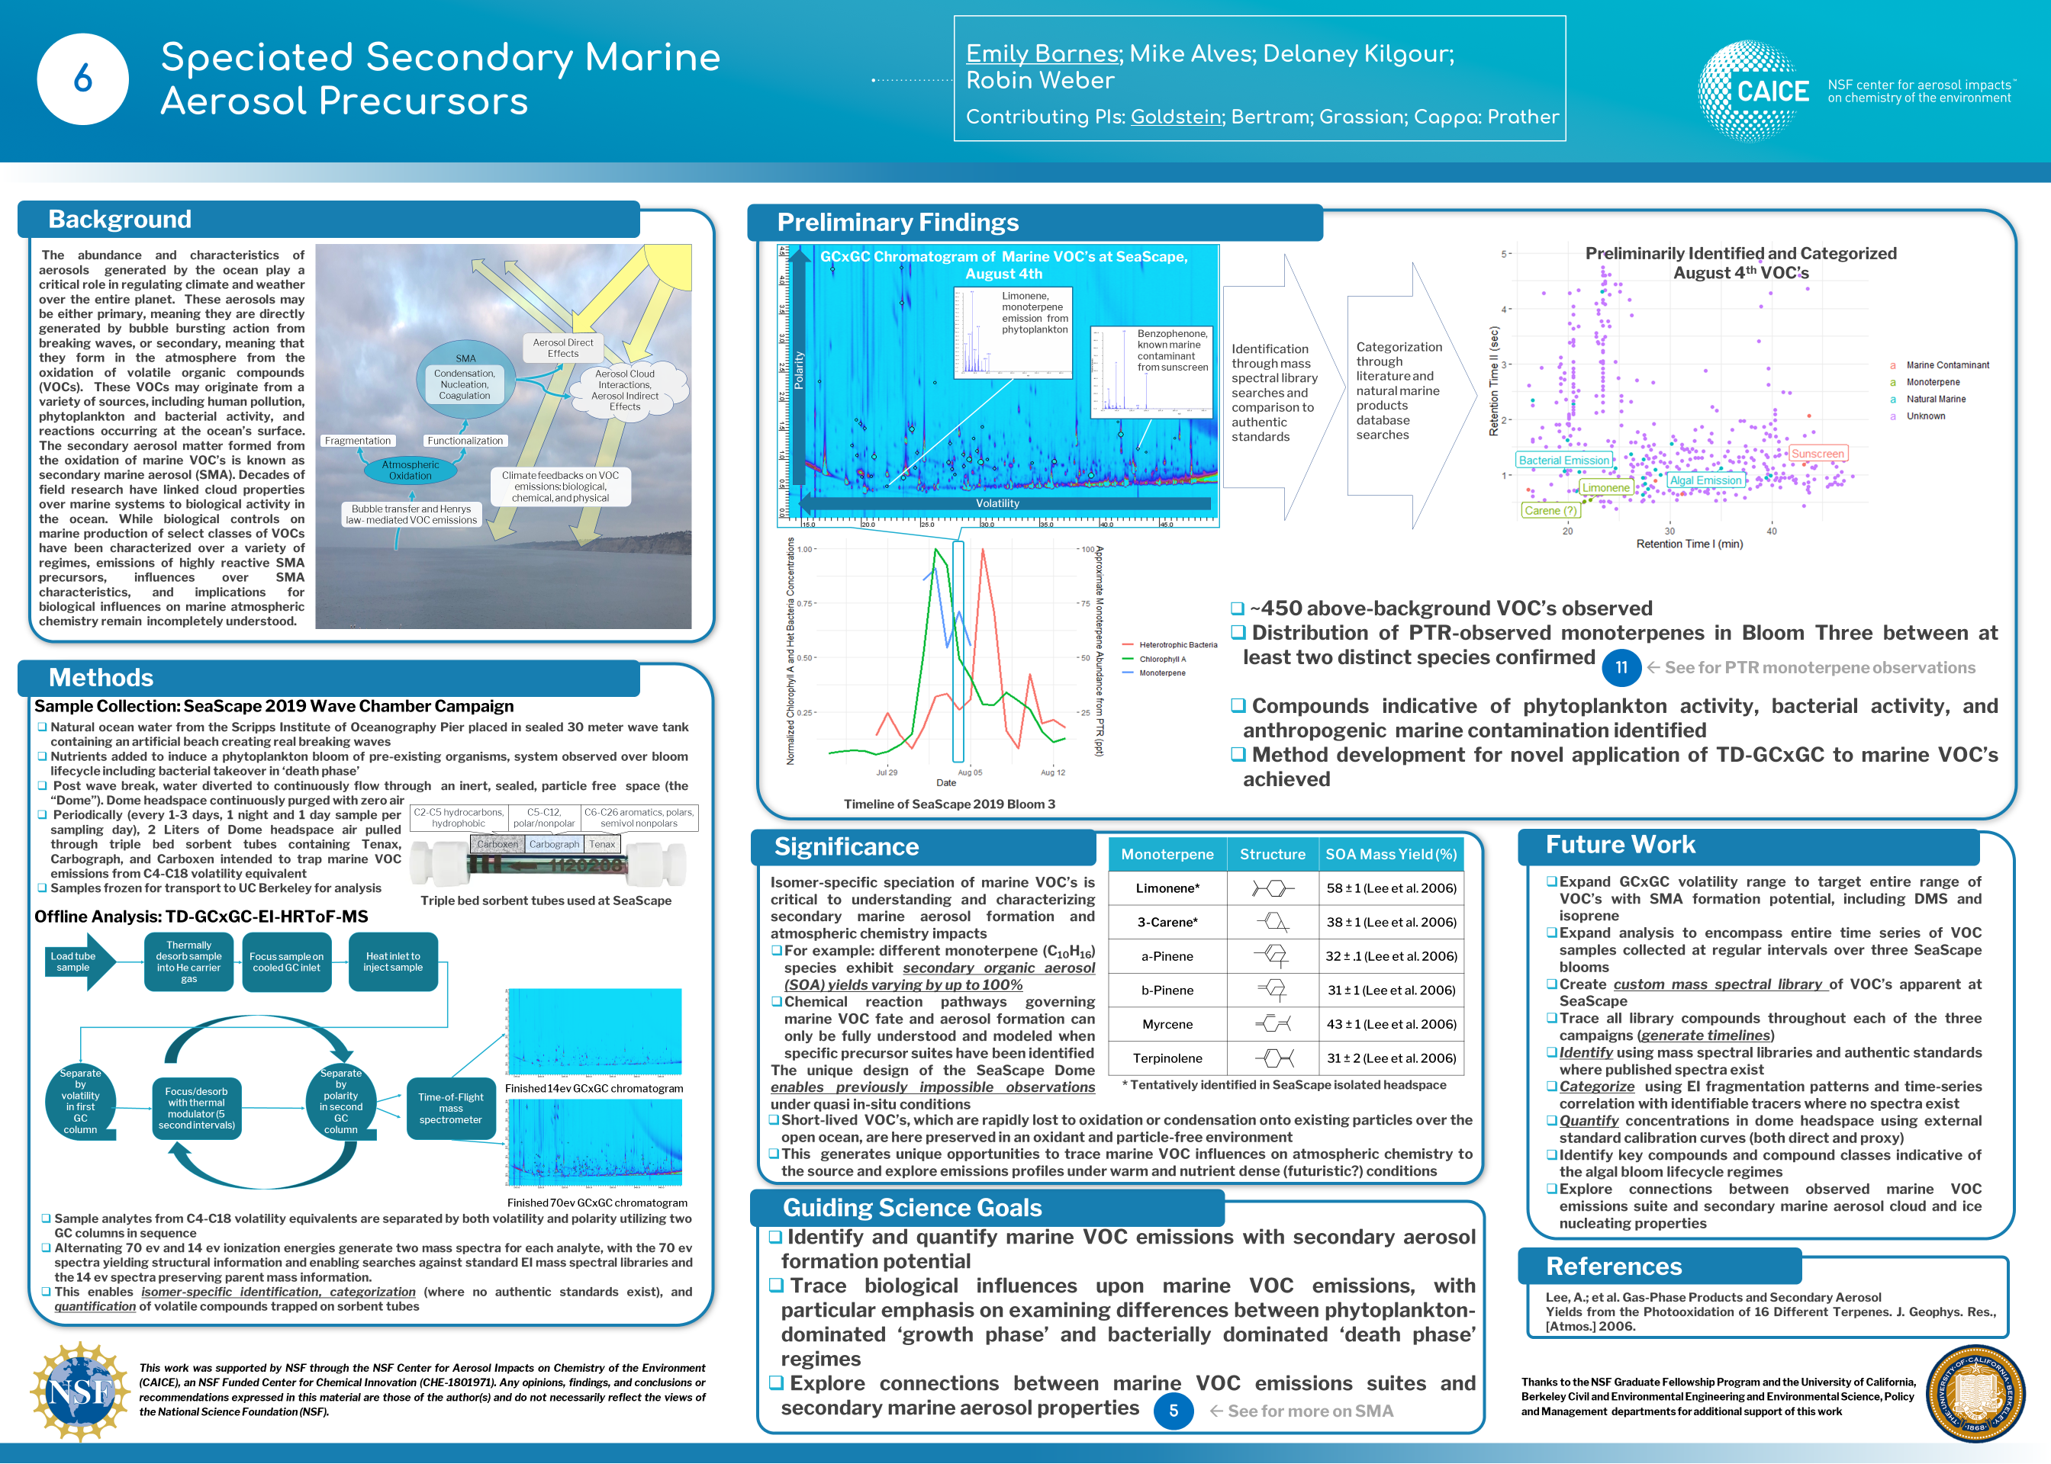
Notes:
Hi my name is Emily Barnes and I am from the Goldstein Group at UC Berkeley. At SeaScape I collected VOC’s which I am analyzing using two-D gas chromatography-EI mass spec. This technique allows me to separate and identify or categorize SMA precursors at the isomer level. The design of the VOC dome at SeaScape gives us a unique opportunity to observe a realistic marine VOC emissions suite, including compounds which would be lost to oxidation or condensation before they could be observed over the open ocean. Our preliminary results have found ~450 unique analytes during a chemically interesting transition period in bloom three. Among these compounds are a mixture of algal emissions, bacterial emissions, and volatilized human contaminants which are commonly present in costal waters. Isomer specific speciation is critical to unraveling SMA formation processes, as different isomers of the same molecular formula oxidize through different pathways and may differ in secondary aerosol yields by an order of magnitude or more.
.

Slide 24
SeaScape 2019
Notes:
SeaScape was an intense experience, and despite(or maybe because of?) that nobody really took very many pictures- in fact the two in the corners are the only ones with me in them from the whole campaign. Each one of these has a story and is very funny to me for one reason or another, but is largely irrelevant to the science on the whole so I thought I would throw them up to give a sense of local flavor

Slide 25
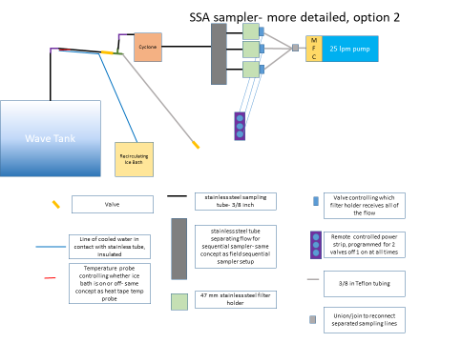
Methodology Sidebar: Nascent Sampling and Wet Filter Woes
Notes:
Here I would like to take a quick detour to explain a challenge I faced right at the beginning of the field campaign which caused lot of stress but from which I learned a lot. On the right you can see a diagram of the primary SSA sampler which I constructed and brought to SeaScape. As I was sampling off of a closed box filled with water in an environment without any sort of temperature regulation, I knew going in that water condensing on my filters was likely to be a problem that would need to be designed around. With the guidance of Nathan and Lindsay, I came up with a plan to have a ~.7 meter cooled section near the beginning of my sampler which would condense out the water from the air and direct the water into a trap while the particles, now in relatively direr air, went into my filter holders. Long story short, despite having pretty extensively tested it in Berkeley it did not get the job done in San Diego- the RH was way higher than the experiment designers had anticipated and all of the filters were coming out soaked

Slide 26
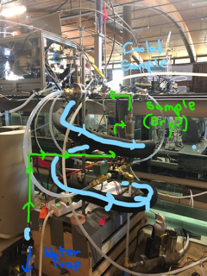
Methodology Sidebar: Nascent Sampling and Wet Filter Woes
Notes:
Here I would really like to thank Nathan, Allen, Lindsay, Robin, and Yutong, because with their advice and expedited part-shipping help I was able to on-site alter my aesthetically pleasing but non-functional design into this Frankenstein’s monster that got the job done-

Slide 27
Methodology Sidebar: Nascent Sampling and Wet Filter Woes
- .7 m steel cooled section replaced by 2.5 m copper cooled section
- Water trap through cyclone heated with heat tape

Slide 28
Methodology Sidebar: Nascent Sampling and Wet Filter Woes
Notes:
Getting it to a point of reliably keeping the filters dry was a long and painful process, and even at the end it worked about 95% of the time. Why that is the case is something of a mystery which still intrigues me.

Slide 29
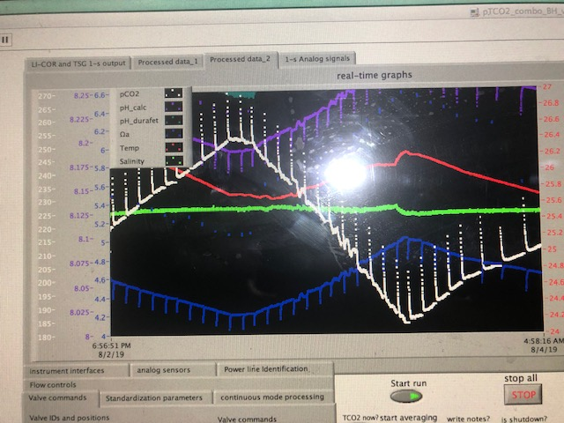
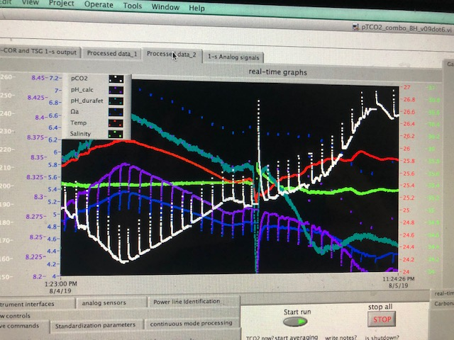
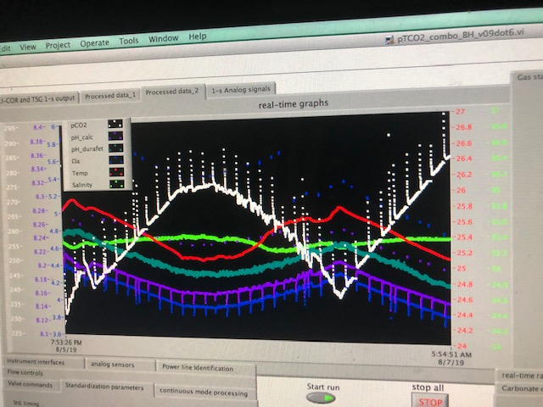
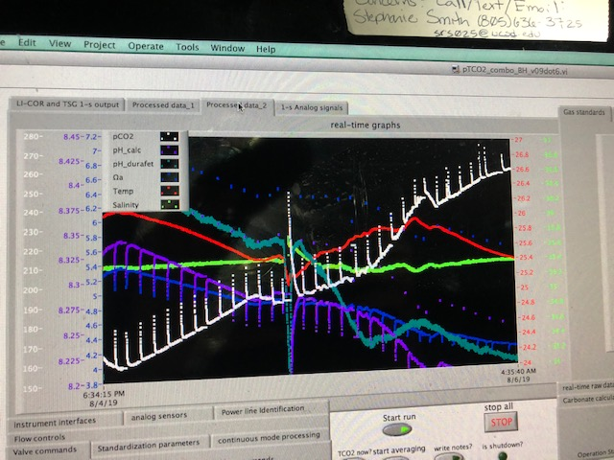
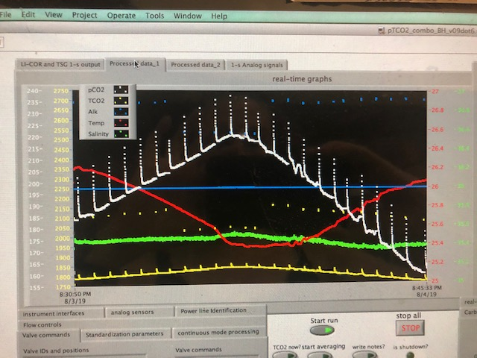
Bloopers

Slide 30
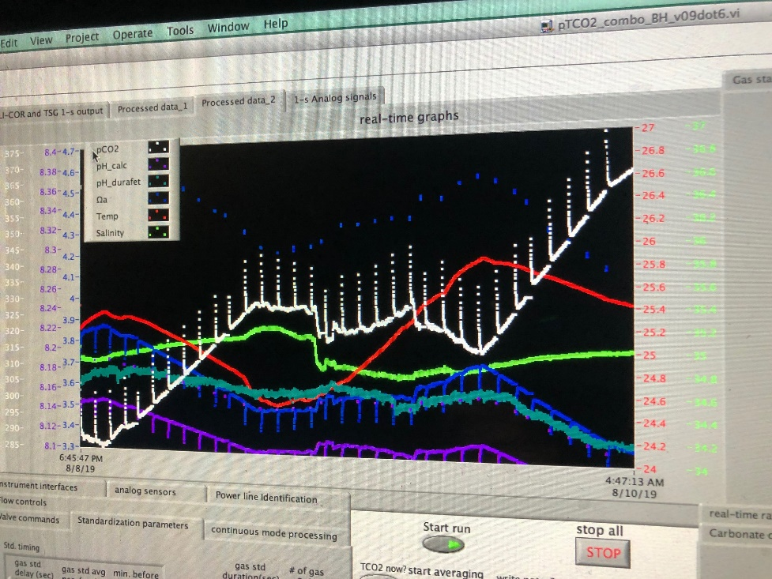
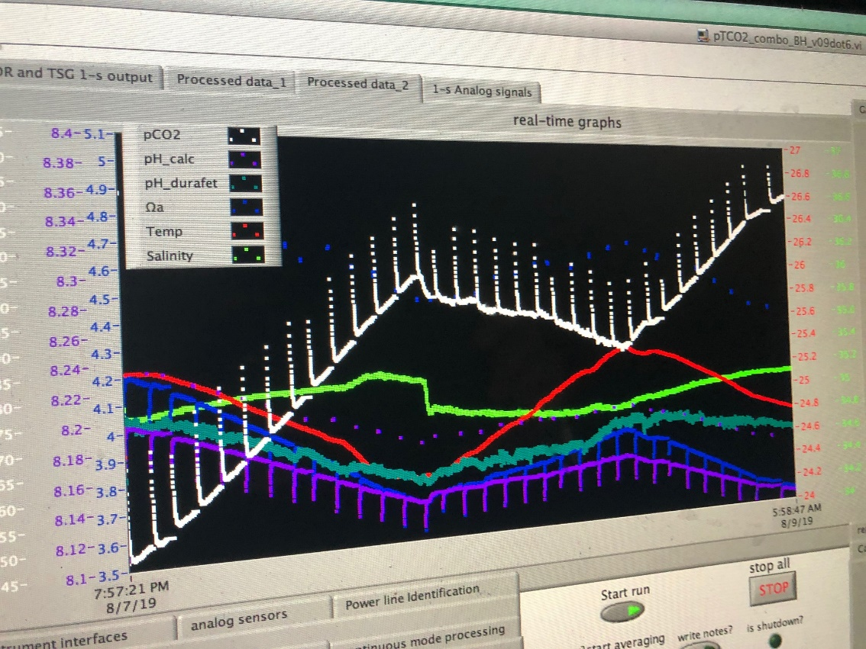
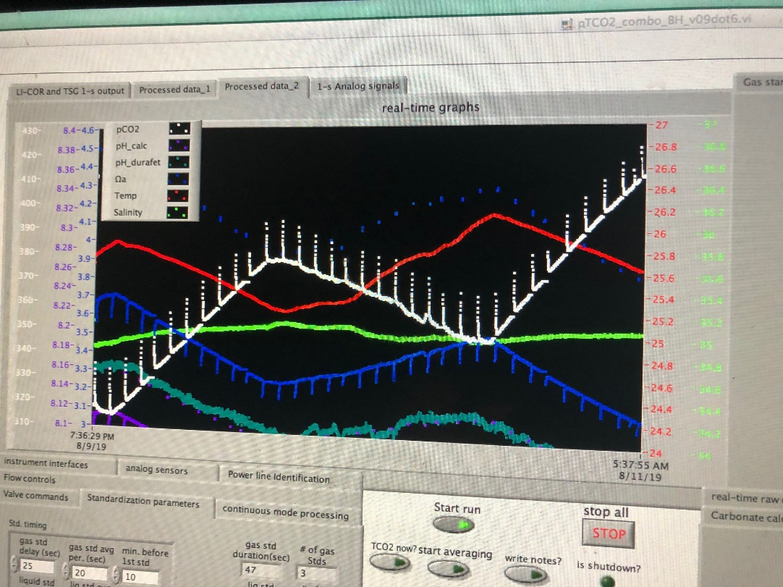
Bloopers

Slide 31
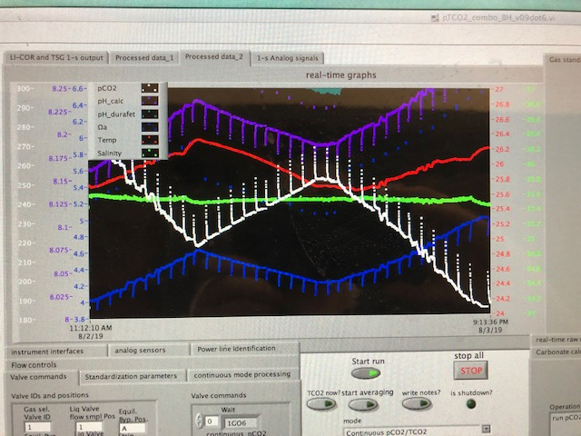
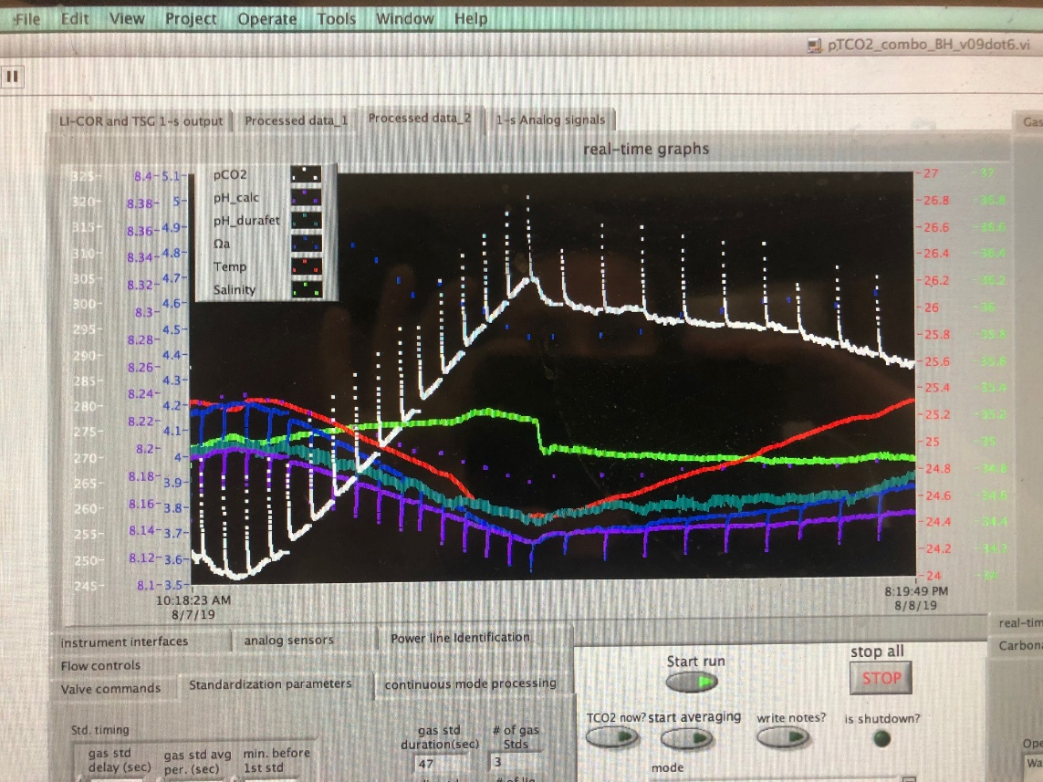
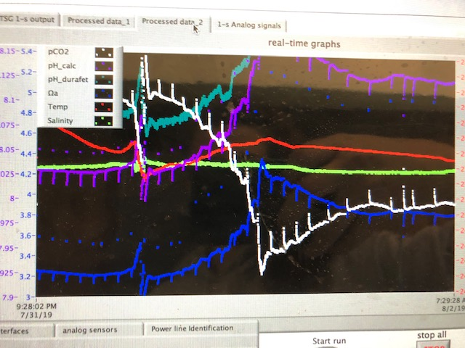
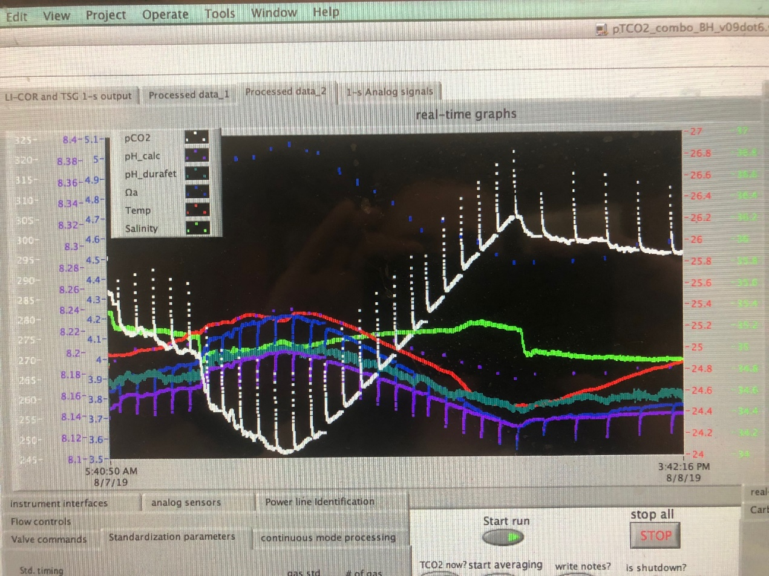
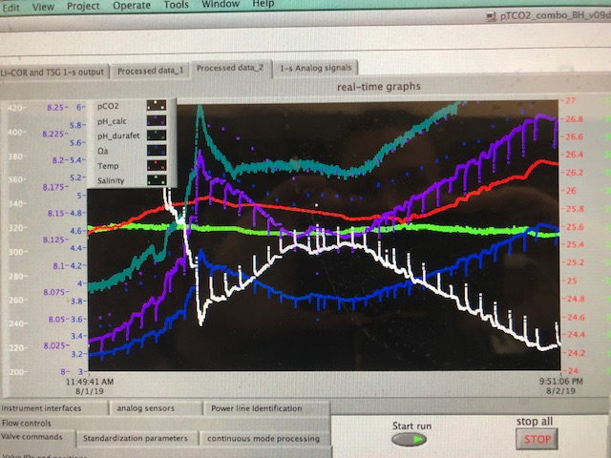
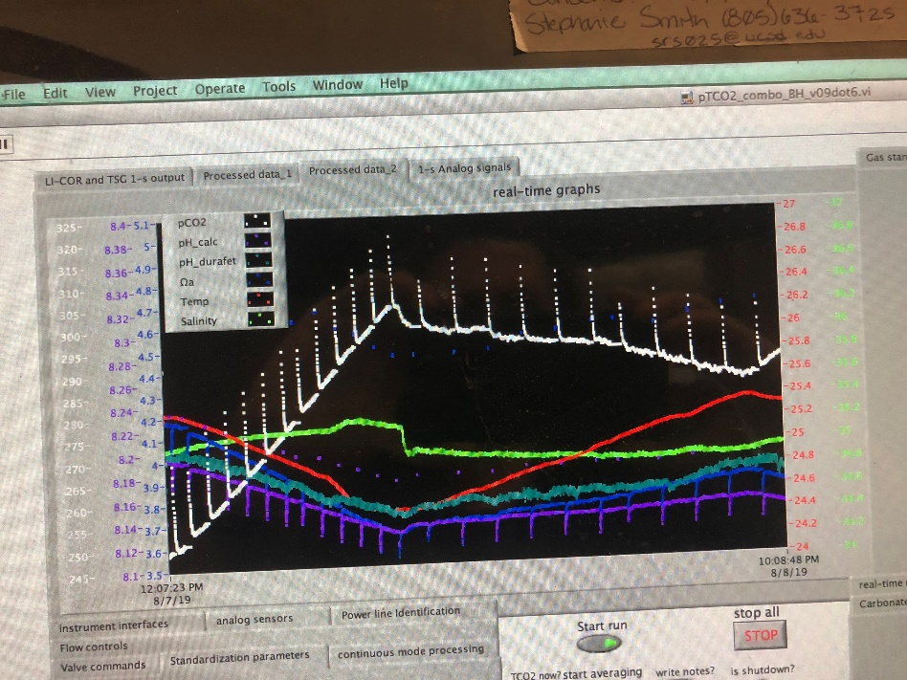
Bloopers

Slide 32
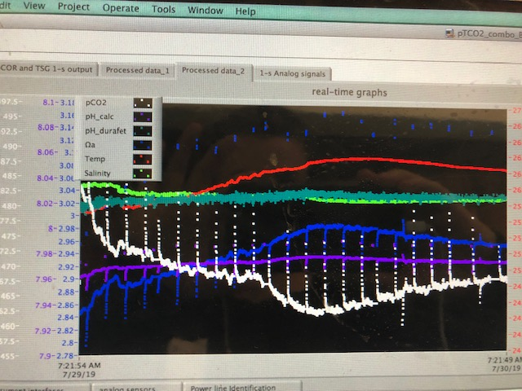
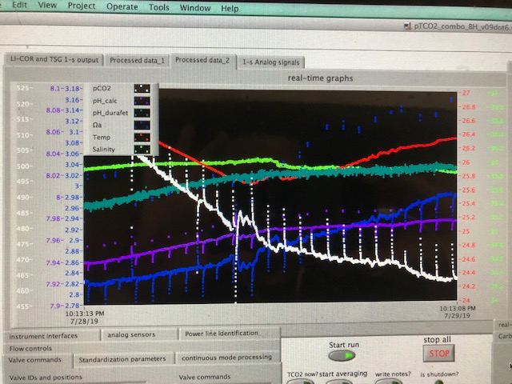
Bloopers

Slide 33
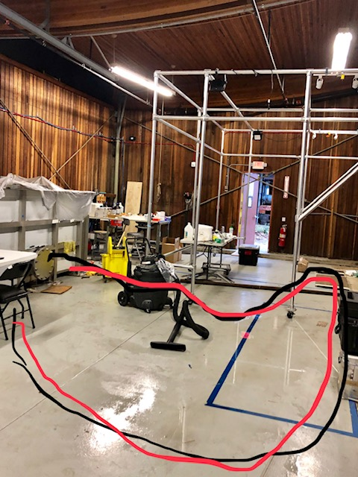
Bloopers
Flood

Slide 34
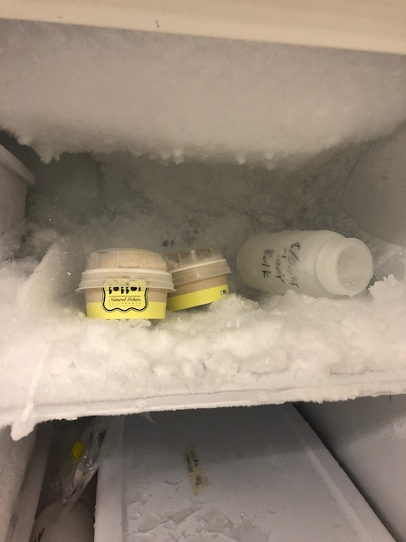
Bloopers

Slide 35
Bloopers
Gelato

Slide 36
Bloopers
Gelato
My Samples

Slide 37

Bloopers
Gelato
My Samples

Slide 38

Bloopers

Slide 39
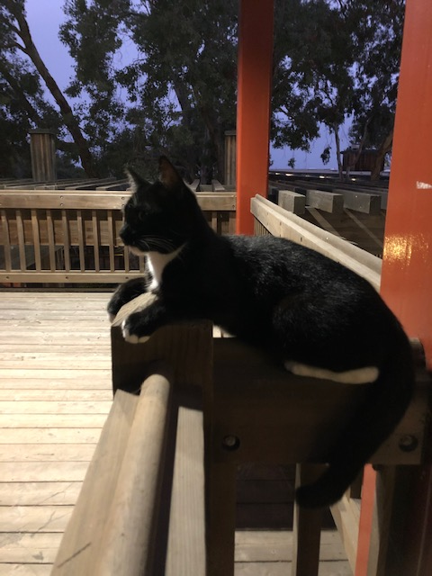

Bloopers

Slide 40
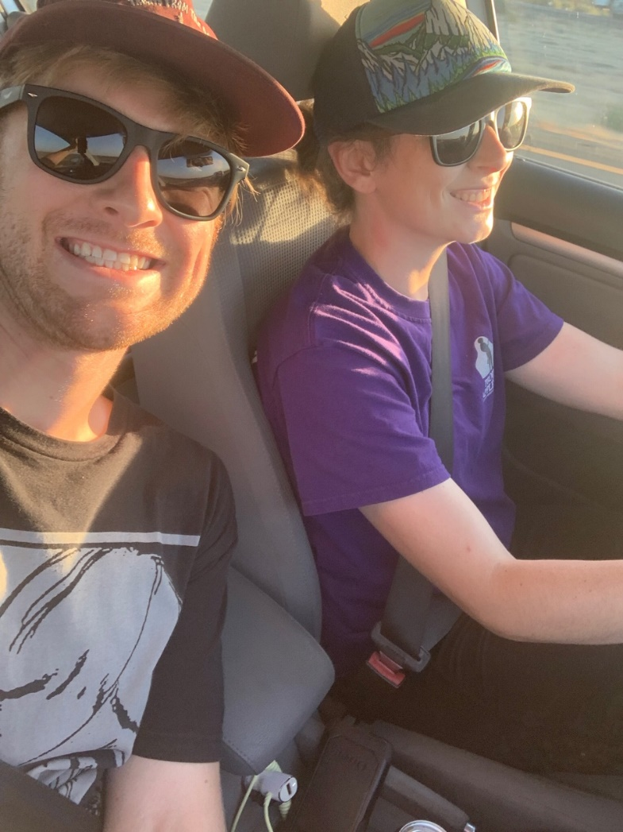
Bloopers

Slide 41
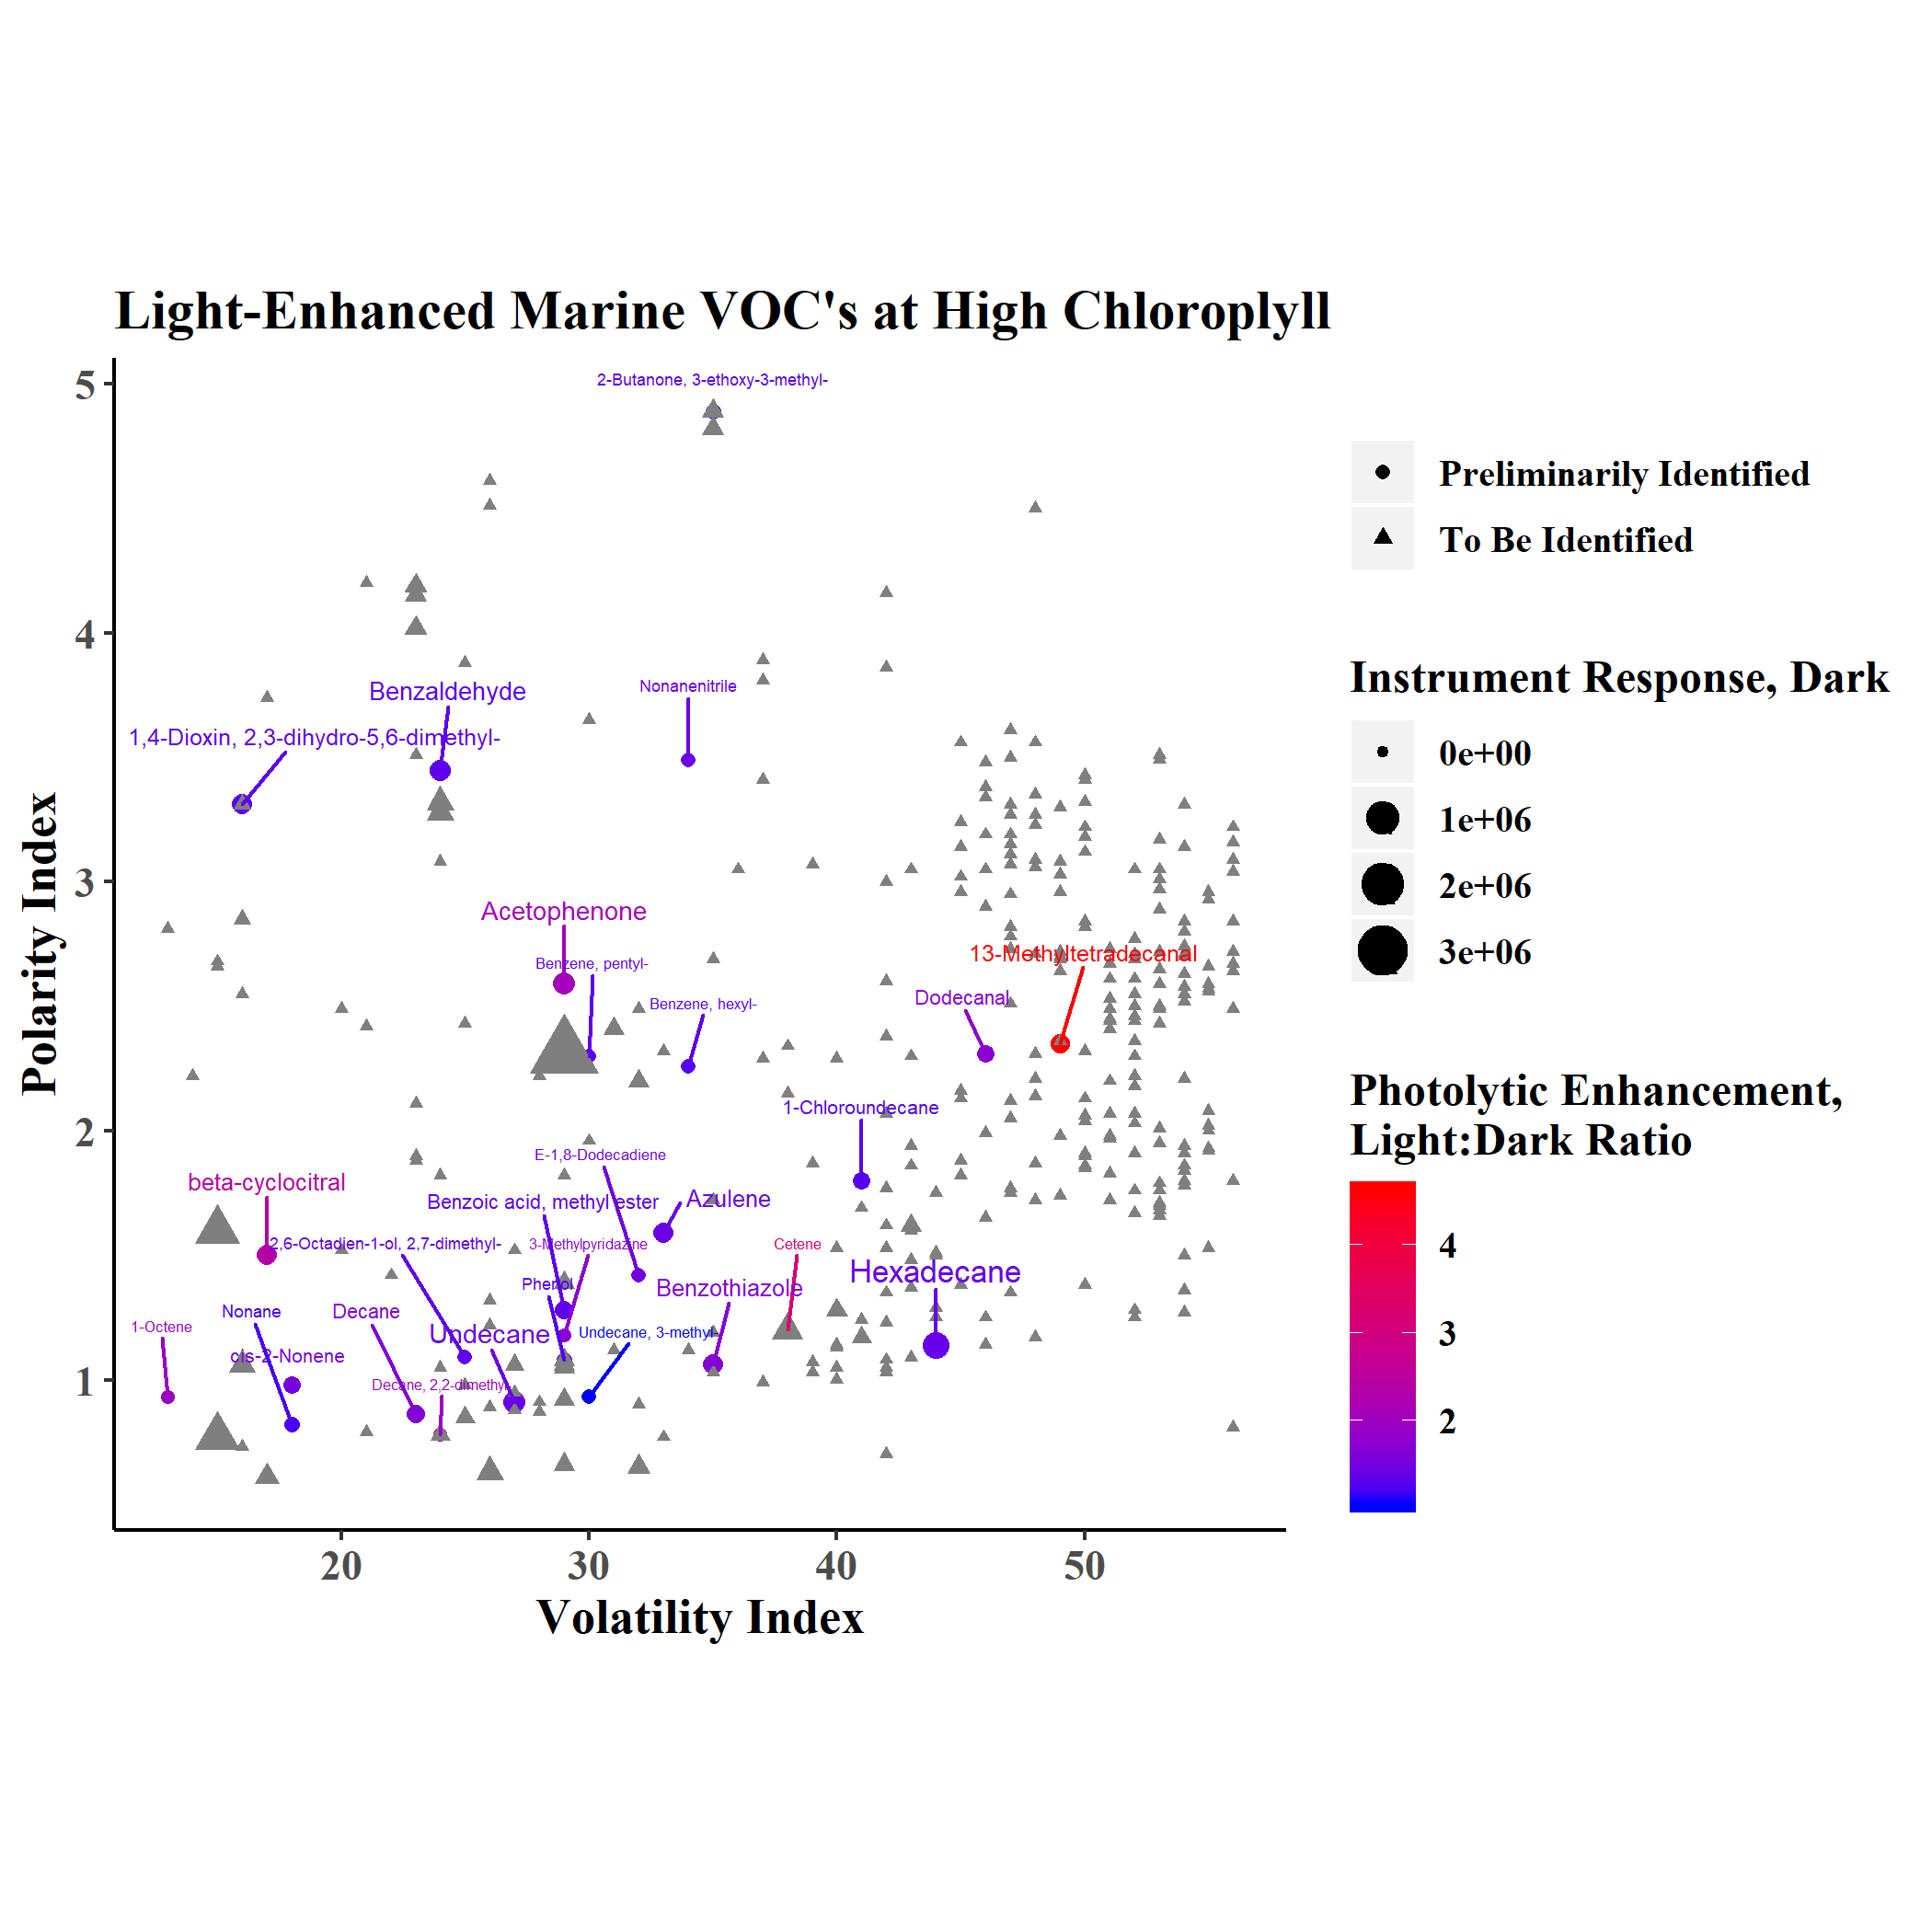



Identification Example: Benzothiazole
14 ev spectrum for parent mass preservation and comparison to orbitrap
70 ev spectrum for isomer-specific identification

